Slide 1
Chapter 2

Slide 2
An Introduction to IANA
The Internet Assigned Numbers Authority (IANA) is a department of ICANN, a nonprofit private American corporation, which oversees global IP address allocation, autonomous system number allocation, root zone management in the Domain Name System (DNS), media types, and other Internet Protocol-related symbols and numbers
The Internet Assigned Numbers Authority (IANA) is responsible for the global coordination of the DNS Root, IP addressing, and other Internet protocol resources. It is a set of functions that is currently contracted out by the National Telecommunications and Information Administration (NTIA), an agency in the U.S. Department of Commerce.

Slide 3
IANA and ICANN
The Internet Corporation for Assigned Names and Numbers is a nonprofit organization that is responsible for the coordination of maintenance and methodology of several databases of unique identifiers
The IANA function is currently carried out by ICANN
Today, “IANA” may refer to either the functions, or the department within ICANN

Slide 4
Why does IANA exist
There is no central control of the Internet If computers did not use the same system of identifiers and numbers to talk to one another, the system would not interoperate
IANA coordinates the numbering systems needed to ensure the Internet interoperates globally
ICANN was devised to be the institutional home for the IANA

Slide 5
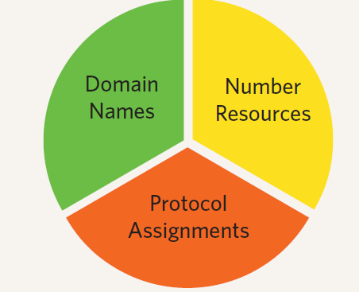
IANA services
IANA is broadly responsible for the allocation of globally unique names and numbers that are used in Internet protocols that are published as Request for Comments (RFCs) documents. These documents describe methods, behaviors, research, or innovations applicable to the working of the Internet and Internet--‐connected systems.
IANA also maintains a close liaison with the Internet Engineering Task Force (IETF) and RFC Editorial team in fulfilling this function

Slide 6
Number Resources
Internet Protocol (IP) Addresses
Unique identifier for each computer connected to the public Internet
Version 4 — currently in use
Version 6 — under deployment
Autonomous System (AS) Numbers
Unique identifier for each network that cross-connects with other networks

Slide 7
Number Allocation Systems
Most numbers allocated in large blocks to Regional Internet Registries (RIR)
Some blocks held by IANA for special purposes (private use blocks, etc.)
Some blocks allocated directly by IANA (multicast address space, protocol specific use)

Slide 8
Domain names
IANA administers the data in the root name servers, which form the top of the hierarchical DNS tree. This task involves cooperate with top-‐level domain operators, the root name server operators, and ICANN‘s policy-making tools
ICANN also operates the .int registry for international treaty organizations, the .arpa zone for Internet infrastructure purposes, including reverse DNS service, and other critical zones such as root-servers

Slide 9
Protocol parameters
IANA administers many parameters of IETF (Internet Engineering Task Force )protocols. Examples include the names of Uniform Resource Identifier (URI) schemes and character encodings recommended for use on the Internet. This task is undertaken under the oversight of the Internet Architecture Board, and the agreement governing the work is published in RFC 2860.

Slide 10
Time zone database
The IANA time zone database holds the time zone differences and rules for the various regions of the world and allows this information to be mirrored and used by computers and other electronic devices to keep accurate track of time zones through the Internet

Slide 11
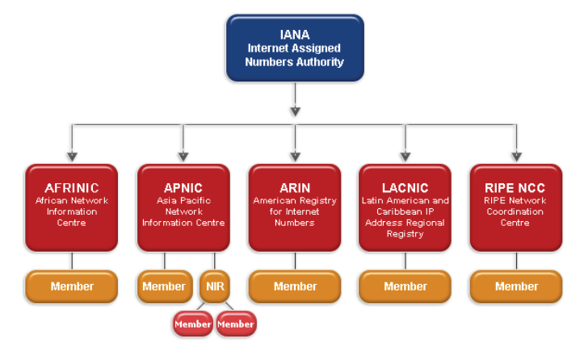
Regional Internet registry (RIR)

Slide 12
Regional Internet registry (RIR)
A regional Internet registry (RIR) is an organization that manages the allocation and registration of Internet number resources within a particular region of the world. Internet number resources include IP addresses and autonomous system (AS) numbers
Registry Geographic Region
AFRINIC -Africa, portions of the Indian Ocean
APNIC -Portions of Asia, portions of Oceania
ARIN -Canada, many Caribbean and North Atlantic islands, and the United States
LACNIC -Latin America, portions of the Caribbean
RIPE -NCC Europe, the Middle East, Central Asia

Slide 13
RIRs and IANA
Regional Internet Registries are components of the Internet Number Registry System, which is described in IETF RFC 7020. The Internet Assigned Numbers Authority (IANA) delegates Internet resources to the RIRs who, in turn, follow their regional policies to delegate resources to their customers, which include Internet service providers and end--‐user organizations

Slide 14
National Internet Registries (NIR)
A National Internet Registry (or NIR) is an organization under the umbrella of a Regional Internet Registry with the task of coordinating IP address allocations and other Internet resource management functions at a national level within a country or economic unit.
NIRs perform Internet number delegations and registrations in line with RIR policies. NIRS that serve their respective Internet communities in the local languages

Slide 15
Some NIRs
Asia Pacific, APNIC
APJII (Indonesia)
CNNIC (China)
IRINN (India)
JPNIC (Japan)
KISA (Republic of Korea)
TWNIC (Taiwan)
VNNIC (Vietnam)
Latin American (LACNIC)
NIC Mexico
NIC Brazil
NIC Chile

Slide 16
NIR quick facts
Each economy may only have one NIR.
NIRs have their own fee schedules in local currency for their members, and they pay membership fees to APNIC.
Government endorsement is required to establish an NIR, although this is not an ongoing requirement.
NIRs can have their own policies that apply only to their members, but those policies must not conflict with regional and global policies

Slide 17
local Internet registry (LIR)
A local Internet registry (LIR) is an organization that has been allocated a block of IP addresses by a regional Internet registry (RIR), and that assigns most parts of this block to its own customers
Most LIRs are Internet service providers, enterprises, or academic institutions.
Membership in a Regional Internet registry is required to become an LIR

Slide 18
Internet Service Provider (ISP)
An Internet Service Provider (ISP) is a company that provides you with access to the Internet, usually for a fee. The most common ways to connect to an ISP are by using a phone line (dial-up) or broadband connection (cable or DSL)

Slide 19
Service provided by ISPs
Facilities for access to the public Internet (dial-in, leased line, cable, ADSL, etc.)
Fixed or dynamic IP addresses, in conjunction with access facilities
E-mail accounts
Acting as an agent for domain name registration
Storage and other facilities for web hosting (hosting of web pages)
Support in case of problems
Consulting services
Additional features such as spam prevention

Slide 20
Some associate organization
Internet Engineering Steering Group (IESG):
approves standards
Internet Architecture Board(IAB)
Architectural oversight
Elected by ISOC
Internet Society: ISOC
Conferences
“hosts” IANA

Slide 21
Internet Engineering Task Force (IETF)
The Internet Engineering Task Force (IETF) is a large open international community of network designers, operators, vendors, and researchers concerned with the evolution of the Internet architecture and the smooth operation of the Internet.
It is open to any interested individual.

Slide 22
Function of IETF
published goals and milestones
disputes resolved by discussion and demonstration (mostly...)
“Rough consensus (and running code!)”
standardization only after several implementations

Slide 23
Internet Standards _ RFCs
“Request for Comments”, since 1969
most RFCs are not standards!
Internet drafts: working documents, but often used for prototypes

Slide 24
Number Resource Organization (NRO)
The Number Resource Organization (NRO) is a coordinating body for the five Regional Internet Registries (RIRs) that manage the distribution of Internet number resources including IP addresses and Autonomous System Numbers.
Each RIR consists of the Internet community in its region.

Slide 25
Address Supporting Organization (ASO)
The Address Supporting Organization (ASO) is a supporting organization affiliated with ICANN.
It was founded in 1999. Its members make up the Address Council

